Slide 1
Zela Aviation
Aircraft Remarketing

Slide 2
Aircraft Remarketing What we offer
Promote your aircraft for:
Sale or Dry Lease
Short term and long term ACMI
Prepare all documentation:
NDAs
Contracts
Draft Agreements
Assist on negotiations and represent the client whenever needed:
Attend meetings
Attend Inspection
Prepare Presentations and analysis of all offers on hand to present to the client
Make a comparison of all offers on hand and advise client on which is financially more benefitable

Slide 3
Aircraft Remarketing How it works
The owner of the aircraft provides an exclusive mandate to Zela Aviation
Zela Aviation is marketing the aircraft in online services and publications such as GlobalPlaneSearch, AirFax, MyAirTrade, Speednews etc
Extensive Global Database: Direct exposure to airlines’ upper management and brokers all over the world
Circulars being sent on regular basis
Zela Aviation Website: A dedicated section will be created for each client and each aircraft with all necessary information
Attending Aviation Festivals like Airfinance Dublin, ITB Berlin, WTM London, seeking clients and potential buyers/lessees

Slide 4
Why Zela Aviation
With 12-years presence in the industry of aircraft sales, leasing (ACMI and Dry Lease) and aircraft capacity management, Zela Aviation has built a broad network of clients and contacts around the world.
Currently official ACMI GSA Partner of MIAT Mongolian Airlines and the first ACMI GSA of airBaltic
With offices in Cyprus, Athens (Oct 2019), London and Manchester, Zela Aviation has direct exposure into European, Asian and Northern African Markets. The company has now expanded its network in the North and South American markets, sealing a number of deals.

Slide 5
Other Zela Aviation Services
Brokerage
Aircraft Remarketing
Aircraft Capacity Management
Consulting
ACMI lease
Dry Lease
Aircraft Sales
Charter Flights
Mandated Aircraft
Up-to-date database
Official ACMI GSA of MIAT Mongolia Airlines
Managing airline’s fleet for leasing/ purchasing/sale
Feasibility studies for fleet management for start-ups and established carriers

Slide 6
ACMI Lease
ACMI/Aircraft Leasing team has considerable aircraft charter and lease management experience going back many years.
Working with a large range of carriers globally, always in touch with the current industry trends and their business developments to be in a position to give our clients the best service.
Able to provide aircraft anywhere in the world to meet short, medium and long term requirements

Slide 7
Dry Lease & Aircraft Sales/Acquisition
We support airlines in making the correct choice when selecting an aircraft on dry lease and/or straight purchase.
Zela Aviation is able to draw on a wealth of experience from third parties that has worked with over the years on such projects where there is a need for a specific resource with a specific skill.

Slide 8
Charter Flights
International network of airline contacts enables us to source aircraft charters worldwide.
With Zela Aviation you have a wide variety of aircraft charter options. It could be a one-off aircraft charter or a long-term flight programme; an all-economy airliner, or a VIP-configured aircraft. You simply set the schedule and the route and we will work out all the details to make sure your aircraft is tailored to your requirements and budget.

Slide 9
Consulting
The Zela Aviation Consultancy department offers support and expert advice on all aspects of aviation from the following services:
Feasibility studies for airline / operator start-ups
Business plans
Aircraft acquisition
Fleet Planning
Network Planning

Slide 10
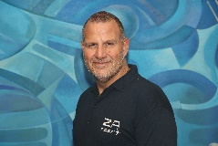
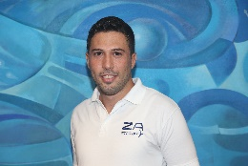
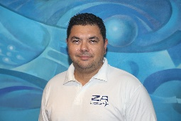
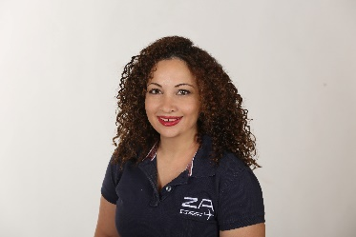
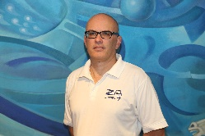
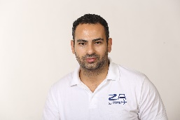
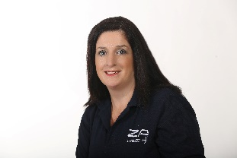
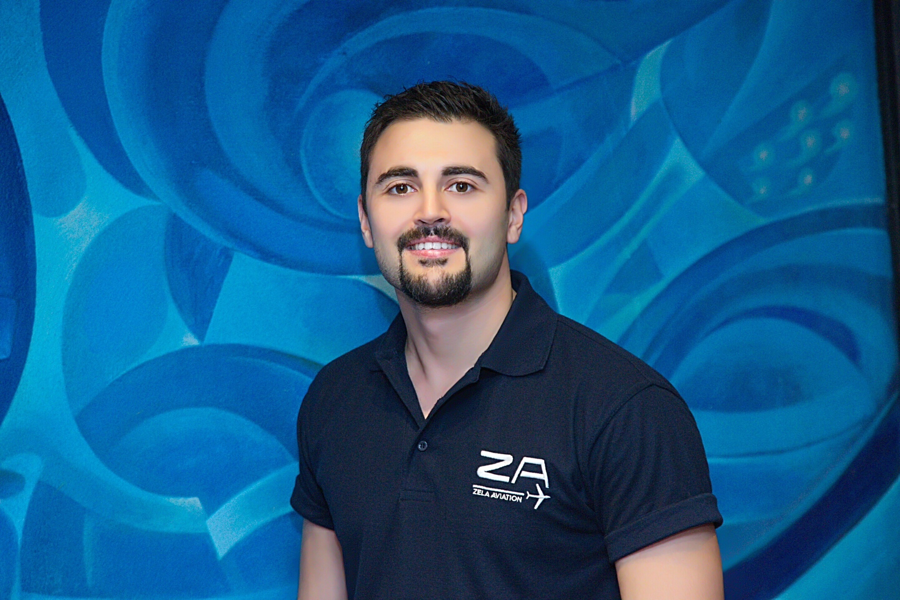
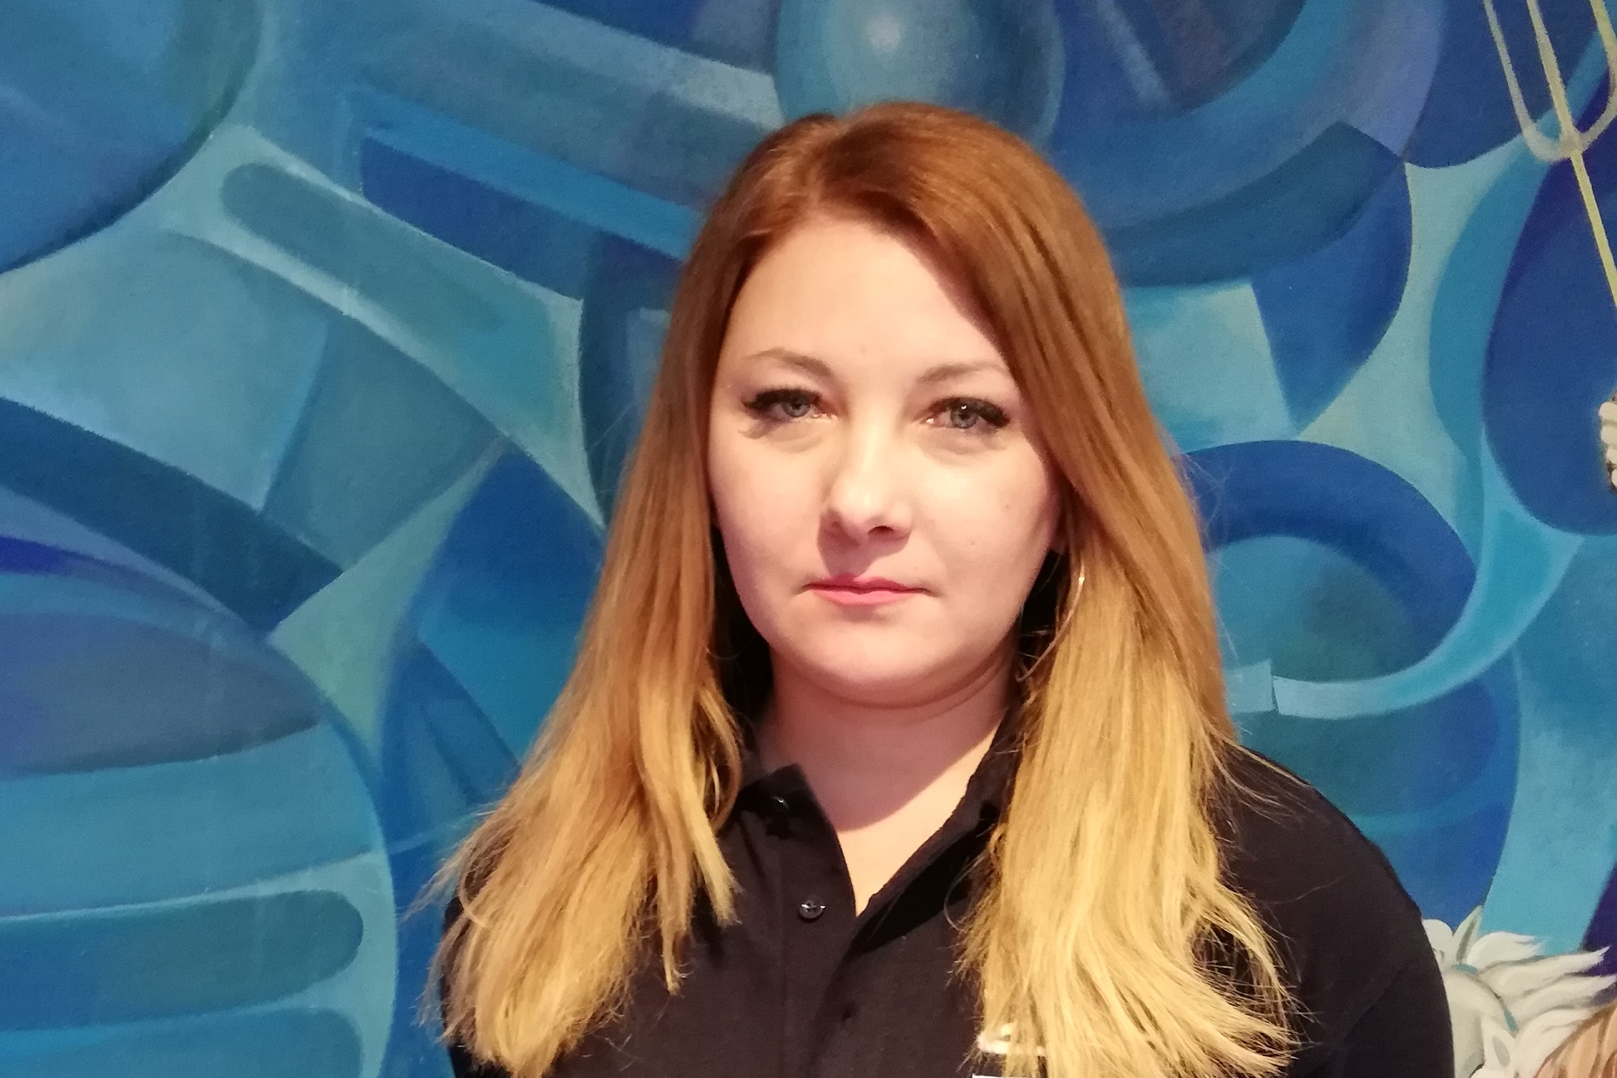
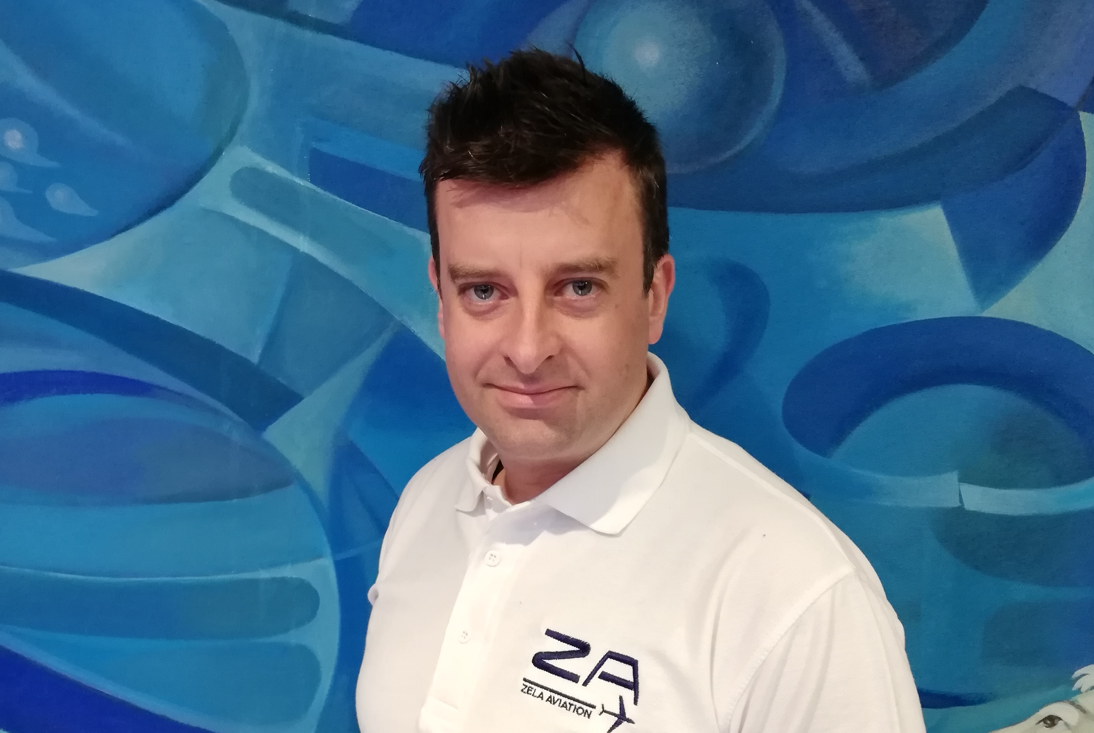
Meet the team
Andreas Christodoulides
Chairman
andreas@zelaaviation.com
Andreas Christoforides
Air Charter Broker
andrew@zelaaviation.com
Maria Zachariou
Marketing & Sales Executive
maria@zelaaviation.com
Matthew Pascoe
Senior Aviation Consultant
matthew@zelaaviation.com
Nikolay Panov
Air Charter Broker
nikolay@zelaaviation.com
Andri Thoma
Chief Accountant
andri@zelaaviation.com
Andreas Pericleous
Business Development Mgr
apericleous@zelaaviation.com
Lorraine Paraskeva
Executive PA to Chairman
pa@zelaaviation.com
Yiorgos Damianidis
Executive Assistant
yiorgos@zelaaviation.com
Rozalia Charilaou
Administration Officer
rozalia@zelaaviation.com
Tasos Papadopoulos
Head of Tactical ACMI
tasos@zelaaviation.com

Slide 11
Contact Us Contact details
Cyprus
UK
Greece
emails:
acmi@zelaaviation.com
drylease@zelaaviation.com
aircraftsales@zelaaviation.com
Tel: +357 99 372 433
+357 99 250 762
+357 25 346 813
emails:
acmi@zelaaviation.com
drylease@zelaaviation.com
aircraftsales@zelaaviation.com
Tel: +44 77 2510 1335
+44 12 7058 3740
emails:
acmi@zelaaviation.com
drylease@zelaaviation.com
aircraftsales@zelaaviation.com
Tel: +30 210 4283 282

